Slide 1
MIPS 16 Bit Processor
By:
Robert Maxwell
&
Ryan Agudelo

Slide 2
MIPS Machine
Microprocessor without Interlocked Pipeline Stages (MIPS)
Reduced instruction set computer (RISC)
Simplified instructions can provide higher performance if the simplicity enables faster execution of each instruction
Instruction set architecture (ISA)
Architecture related to programming
Native data types
Instructions
Registers
Addressing modes

Slide 3
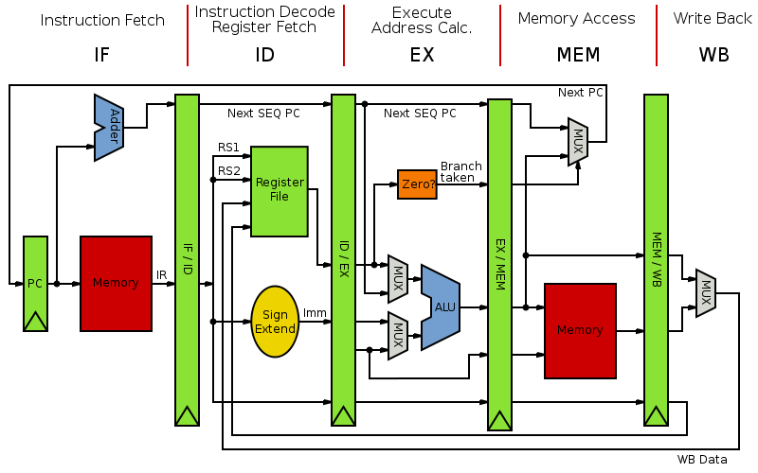
Pipelined MIPS, showing the five stages (instruction fetch, instruction decode, execute, memory access and write back)
MIPS Diagram

Slide 4
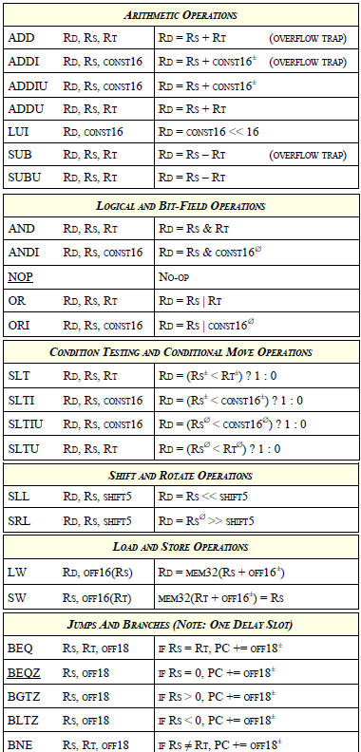
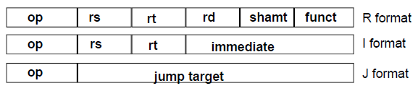
Instruction Set
Assumptions:
Subset of MIPS 1 ISA
Byte/Word = 8/16 bits
All instructions have
R (register), I (immediate) or
J (jump) format.
No Floating Point Co-Processor
Minimum instruction (256 bytes and data memory(512 bytes)

Slide 5
Verilog-HDL Design Procedure
Code the initial hardware and control signals
Test each arithmetic state to verify appropriate functionality
Test Branch functionality
Alter design (if needed – then re-test)
Test for correctness of data
Alter design (if needed – then re-test)
Test the circuit with a program that proves correct operation

Slide 6
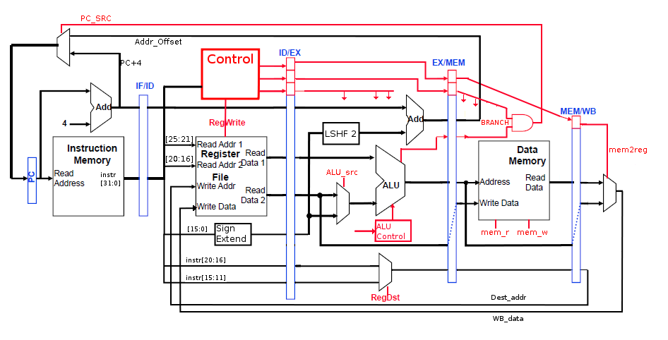
Initial Design
Courtesy of Dr. Byeong Lee : Microcomputer Architecture Lectures (UTSA)

Slide 7
Test Code (Arithmetic)
Instruction | Instruction Code | Expected Result
ADD $1,$2,$3 | 0x00430820 | R1 = 0x00000005
SUB $4,$5,$3 | 0x00A32022 | R4 = 0x00000002
ADDI $6,$2,100 | 0x20460064 | R6 = 0x00000066
ADDU $7,$5,$5 | 0x00A53821 | R7 = 0x0000000A
SUBU $8,$3,$3 | 0x00634023 | R8 = 0x00000000
ADDIU $9,$2,100 | 0x24490064 | R9 = 0x00000066
AND $10,$21,$22 | 0x02B65024 | R10=0x00000014
OR $11,$21,$22 | 0x02B65825 | R11=0x00000017
ANDI $12,$21,100 | 0x32AC0064 | R12=0x00000004
ORI $13,$21,100 | 0x36AD0064 | R13=0x00000075
SLL $14,$2,10 | 0x00407280 | R14=0x00000800
SRL $15,$31,5 | 0x03E07942 | R15=0x00000001
LW $16,$7,9 | 0x8CF00009 | R16=0x00000013
SW $6,$8,10 | 0xAD06000A | MEM[100] = 0x66
LUI $17,100 | 0x3C110064 | R17=0x00640000

Slide 8
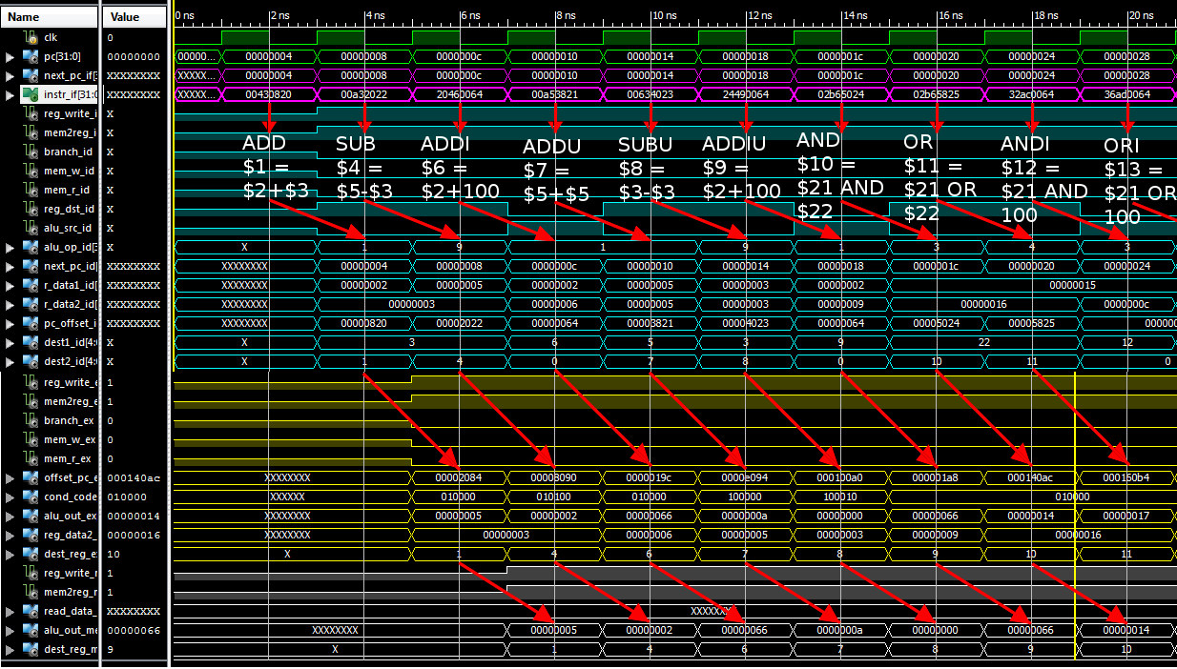
ADD to AND (Immed₁₆)

Slide 9
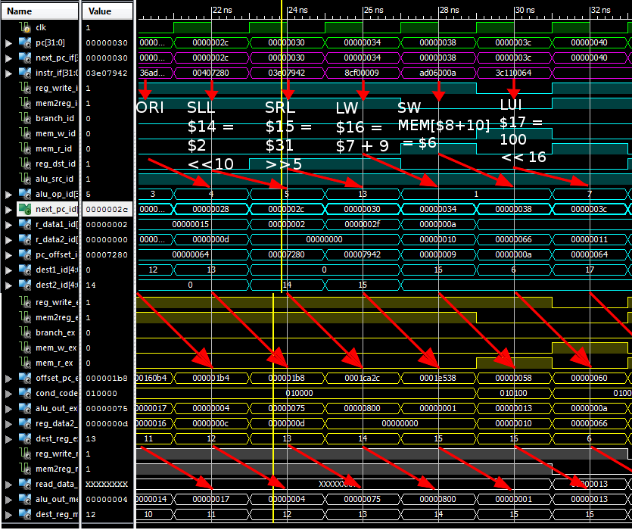
OR (Immed₁₆) to Load Upper (Immed₁₆)

Slide 10
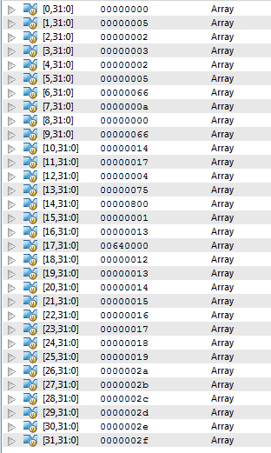
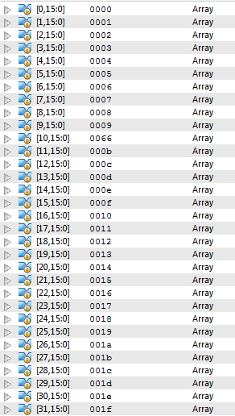
Initial Results
Expected Result
R1 = 0x00000005
R4 = 0x00000002
R6 = 0x00000066
R7 = 0x0000000A
R8 = 0x00000000
R9 = 0x00000066
R10=0x00000014
R11=0x00000017
R12=0x00000004
R13=0x00000075
R14=0x00000800
R15=0x00000001
R16=0x00000013
MEM[100] = 0x66
R17=0x00640000
Register File
Memory

Slide 11
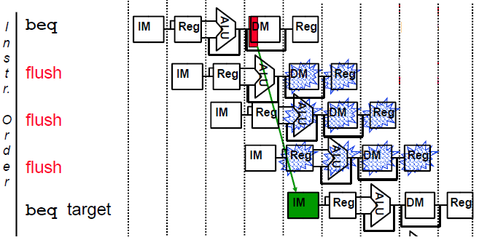
Branch Hazards
If the Branch is taken, next 3 instructions must be burned and flushed from the Pipeline
Courtesy of Dr. Byeong Kil Lee : Microcomputer Architecture Lectures (UTSA)

Slide 12
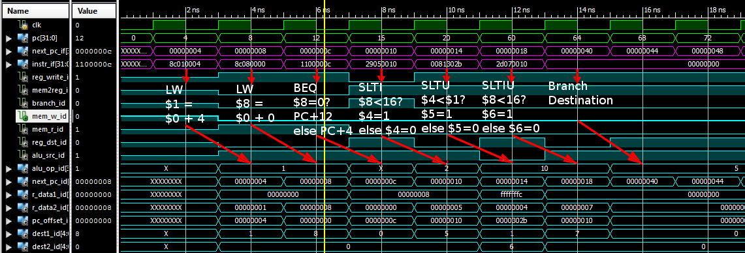
Branch Hazard Example
Branch destination gets loaded 4 cycles after decision

Slide 13
Solutions
Branch Prediction – Many options possible (predict taken, not taken, 2-bit predictor, other algorithms^{[2]})
For this design, we predict not taken
Move branch decision hardware to the ID stage so as to only incur a 1 cycle penalty

Slide 14
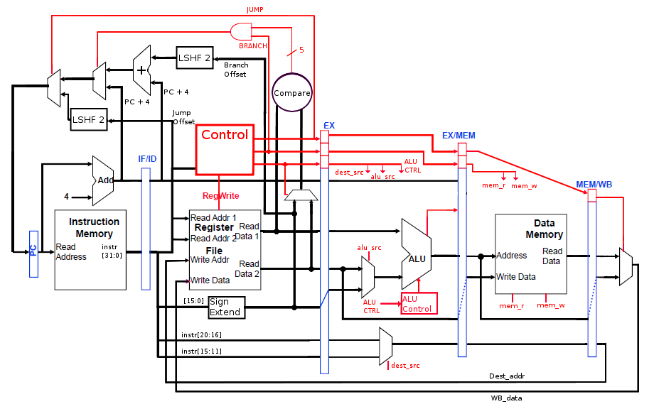
Branch Decision to ID Stage
Adapted from Dr. Byeong Kil Lee : Microcomputer Architecture Lectures (UTSA)

Slide 15
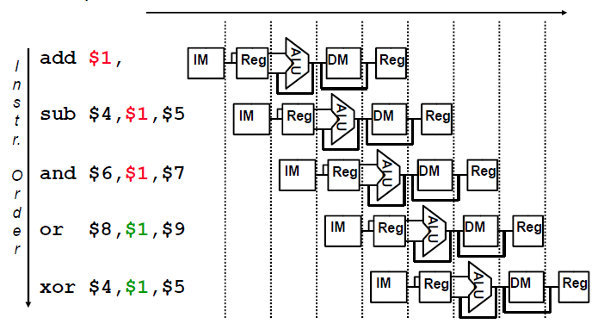
Data Hazards
Occurs when the result of an instruction is required for a subsequent instruction
Courtesy of Dr. Byeong Kil Lee : Microcomputer Architecture Lectures (UTSA)

Slide 16
Solution
Add hardware to the EX stage that tests the destination and source register addresses to determine if the result of an operation is needed by the next few instructions.
Here we compare source1 (EX stage) with source2 (EX stage) with reg_dest (MEM stage) and reg_dest (WB stage)

Slide 17
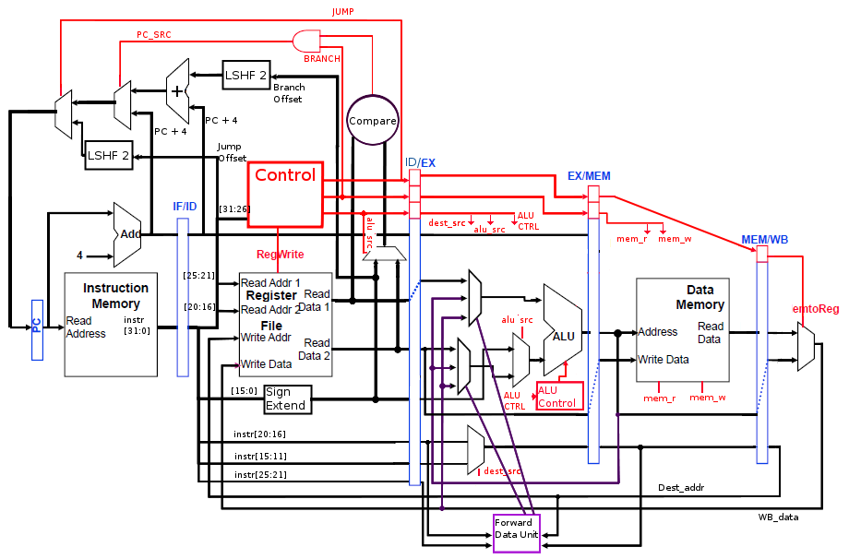
Completed Design
Adapted from Dr. Byeong Kil Lee : Microcomputer Architecture Lectures (UTSA)

Slide 18
Final Design Test Code
Takes sum first ‘n’ Fibonacci numbers and saves to memory^{[3]}
HEX Code
Fib: addi $3,$0,8 // init $3 = n 0x20030008
addi $4,$0,1 //$4 = 1 0x20040001
addi $5,$0,-1 //$5 = -1 0x2005FFFF
Loop: beq $3,$0,end //if $3==0, branch 0x10600008
add $4,$4,$5 //$4 = $4 + $5 0x00852020
sub $5,$4,$5 //$5 = $4 - $5 0x00852822
addi $3,$3,-1 //$3 = $3 – 1 0x2063FFFF
j Loop // jump 0x0800000C
nop 0x00000000
End: stw $4,32($0) //store final value 0xAC040020

Slide 19
Expected Values
n | 8 | 7 | 6 | 5 | 4 | 3 | 2 | 1 | 0
$3 | 8 | 7 | 6 | 5 | 4 | 3 | 2 | 1 | 0
$4 | 0 | 1 | 1 | 2 | 3 | 5 | 8 | 13 | Break
$5 | -1 | 1 | 0 | 1 | 1 | 2 | 3 | 5 | 8
MEM | Prev. | Prev. | Prev. | Prev. | Prev. | Prev. | Prev. | Prev. | 13

Slide 20
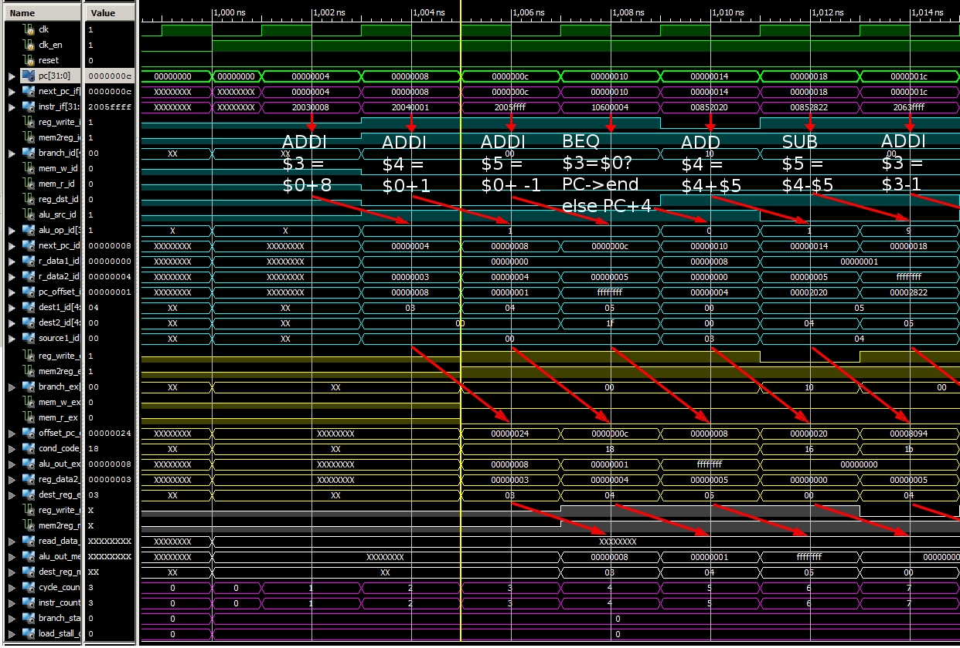
Simulation Results

Slide 21
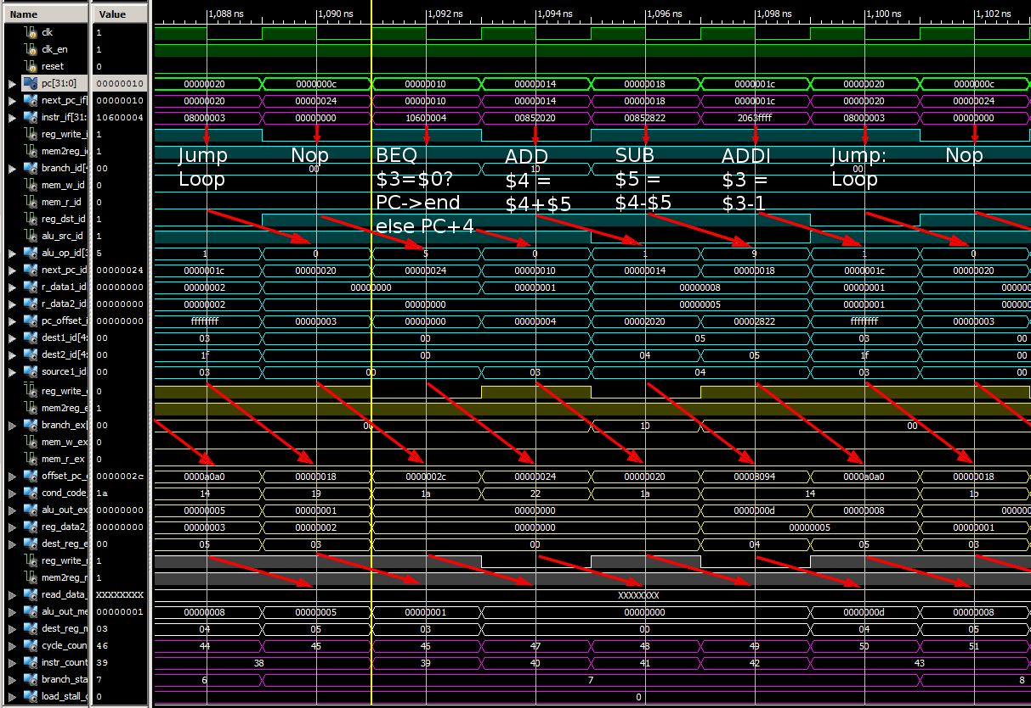

Slide 22
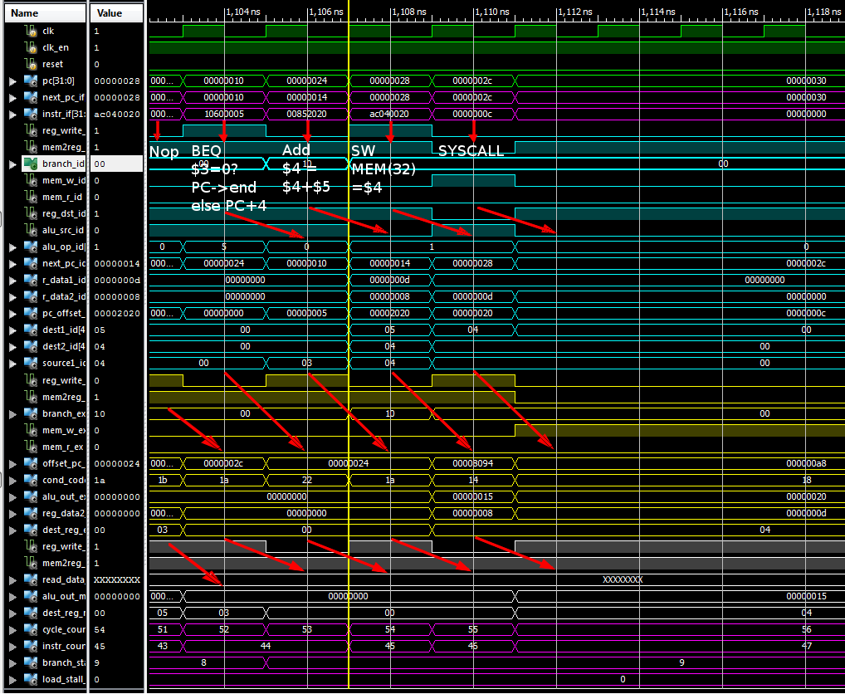
TTL Cycles: 56 Instr. Count: 47 Branch Stalls: 9
IPC: 0.84

Slide 23
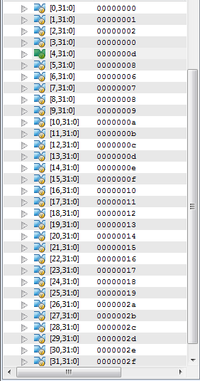
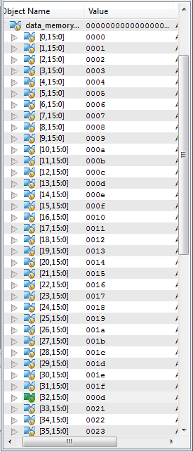
Memory Results
Register File
Data Memory

Slide 24
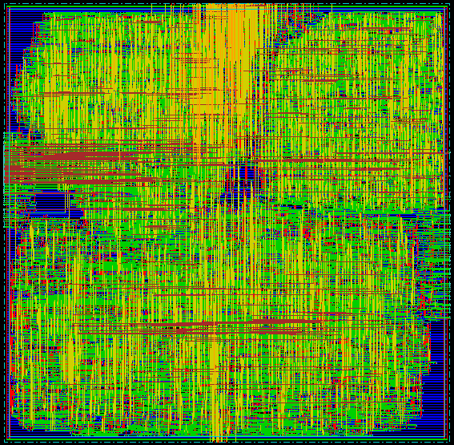
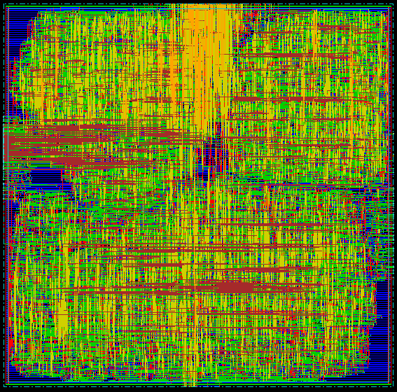
Encounter Layout
Pre Nanoroute
Post Nanoroute

Slide 25

Cadence Encounter
Area
Chip Area: 2.82 x 2.82cm
Core Area: 2.75 x 2.75cm
Standard Cell Area: 1.94 x 1.94cm
Power
Internal: 26.26mW
Leakage: 8.604mW
Total: 34.88mW
Switching: 0.01144mW
Timing
WNS : -26.113ns
TNS: -1708.0ns

Slide 26
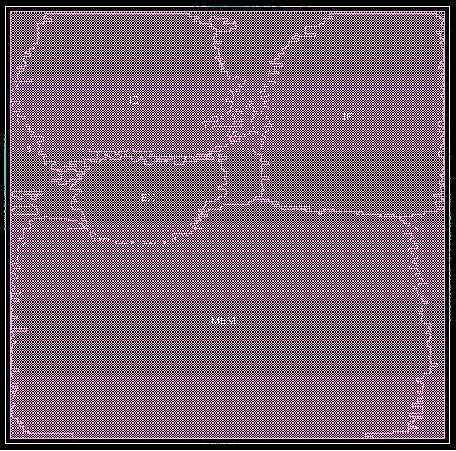
Cell Layout
Instance Cells Cell Area Net Area Wireload
---------------------------------------------------------------------------
mips_16b 15551 375753 0 <none> (D)
MEM 7618 203965 0 <none> (D)
54%
IF 3037 50432 0 <none> (D)
13%
ID 2951 67815 0 <none> (D)
18%
EX 1103 19064 0 <none> (D)
5%
Amoeba Space Allocation Layout

Slide 27

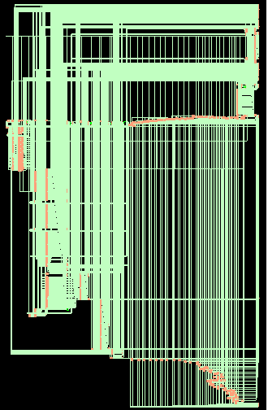
Schematics
RTL Generated Schematic
Complete Encounter Generated Schematic

Slide 28
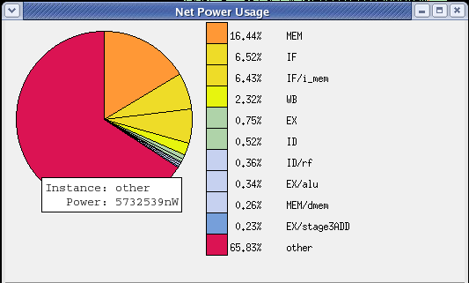
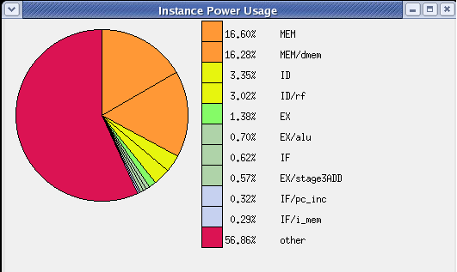
Power
Area of Power Net Distribution
Layer Name | Area of Power Net | Routable Area | Percentage
Metal1 | 60802.0000 | 756898.0524 | 8.0331%
Metal2 | 1536.8672 | 756898.0524 | 0.2030%
Metal3 | 782.8832 | 756898.0524 | 0.1034%
Metal4 | 0.0000 | 756898.0524 | 0.0000%
Metal5 | 0.0000 | 756898.0524 | 0.0000%
Metal6 | 0.0000 | 756898.0524 | 0.0000%
Compiler GUI Yielded some interesting details
bash% rc –f <gfile>.g -gui

Slide 29
Physical Chip Characteristics
Wire Length Distribution
Total Metal1 wire length | 46548.3450 um
Total Metal2 wire length | 311237.6350 um
Total Metal3 wire length | 372118.1150 um
Total Metal4 wire length | 194577.3200 um
Total Metal5 wire length | 71558.7500 um
Total Metal6 wire length | 15791.4500 um
Total wire length | 1011831.6150 um ≈ 40 inches
Average wire length/net | 56.1629 um

Slide 30
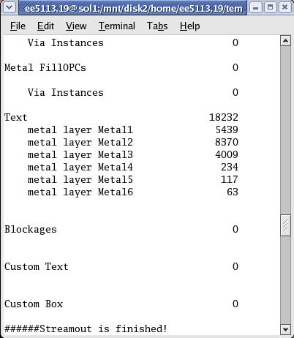
Summary
Prototype MIPS_16B:
Library: tsmc18 – 0.18um tech
Vdd: 1.8Vdc
Total Area: 2.82 x 2.82cm
Total Power: 34.88mW
Pin Count: 540 ext. pins

Slide 31
Questions?

Slide 32
Bibliography
[1] Dr. Byeong Lee, Computer Architecture Lectures, Lecture 3 – Pre_0,1,2,3 MIPS, University of Texas at San Antonio, Feb. 09, 2011.
[2] Hennessy, John and Patterson, David. Computer Architecture: A Quantitative Approach, 4th Edition. San Francisco: Elsevier,2007
[3] David Harris, Introduction to VLSI, Lecture 2: MIPS processor example, Harvey Mudd College, http://www.cmosvlsi.com/lect2.pdf, Spring 2004

